Slide 1
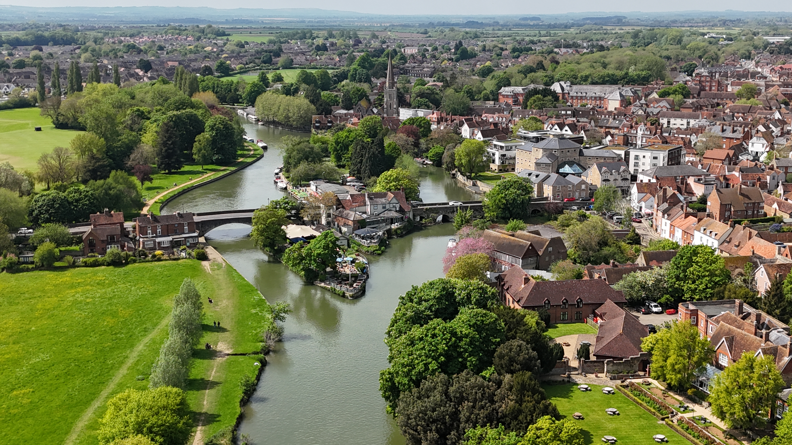
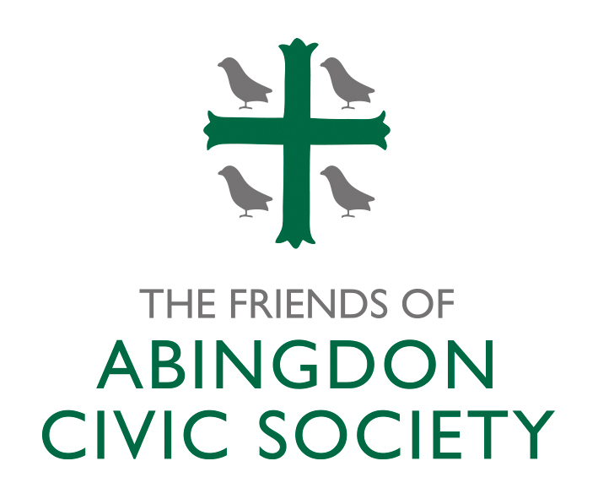
The Friends of Abingdon Civic Society
Caring for our Past, Present and Future
Notes:
Presentation to the 80th Anniversary event on 27 June 2024

Slide 2
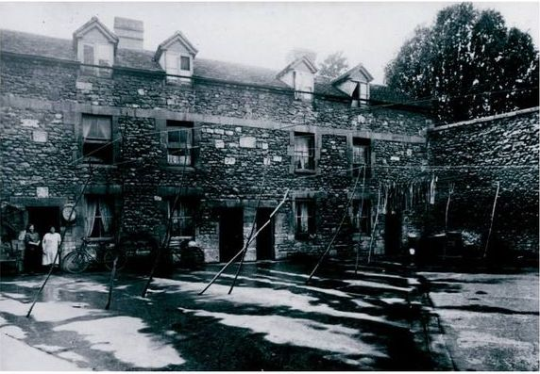
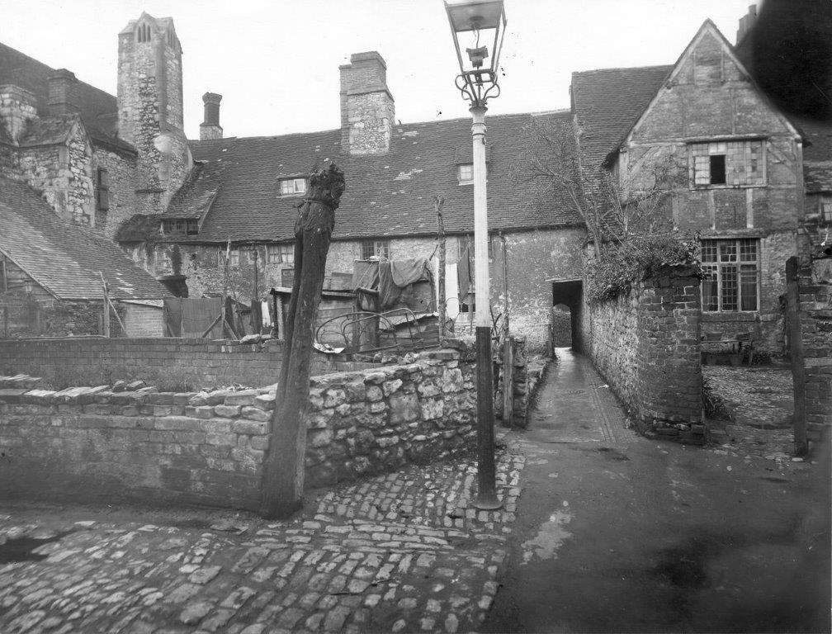
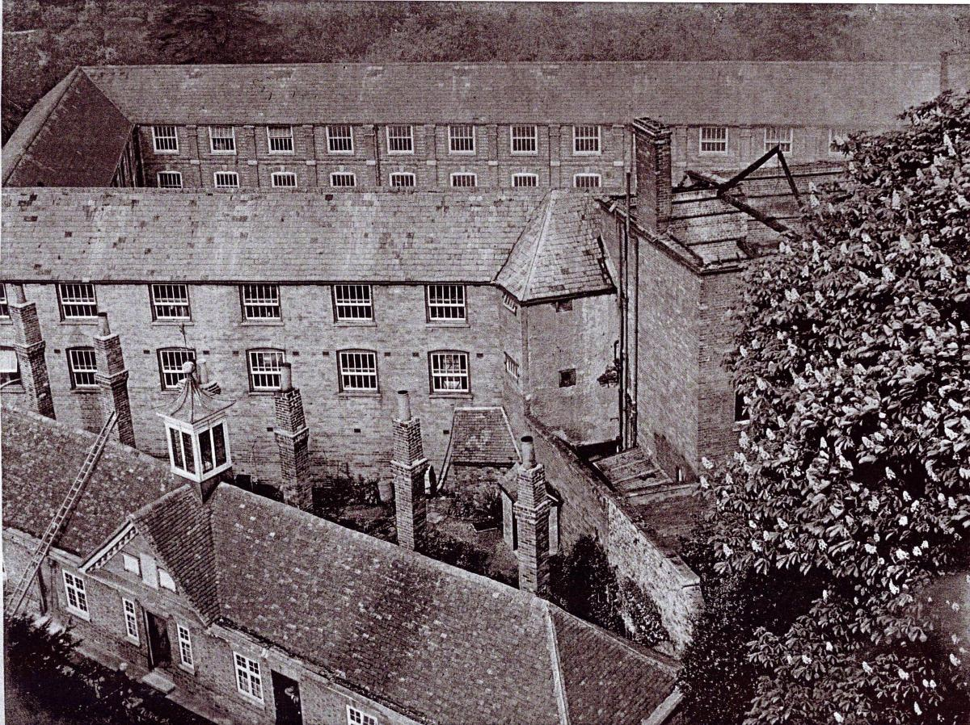
The Past
Notes:
Abingdon in early 1944
As in many other towns, Abingdon’s historic buildings were suffering from neglect due to the wars and economic depression.
But despite the war, plans were in hand for large-scale demolition and clearances
Many people were concerned that historically significant buildings would be lost – and inappropriate buildings put in their place.

Slide 3
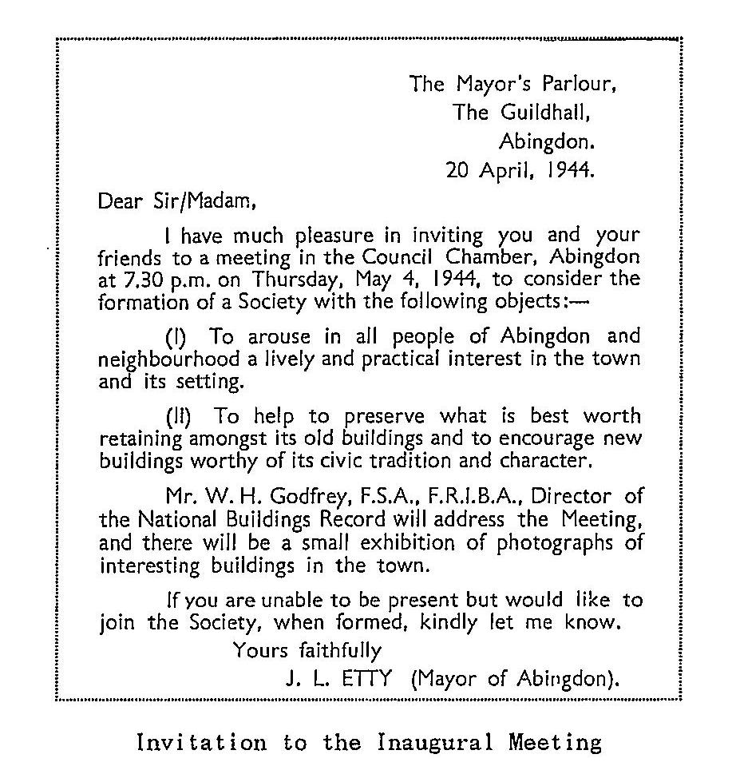
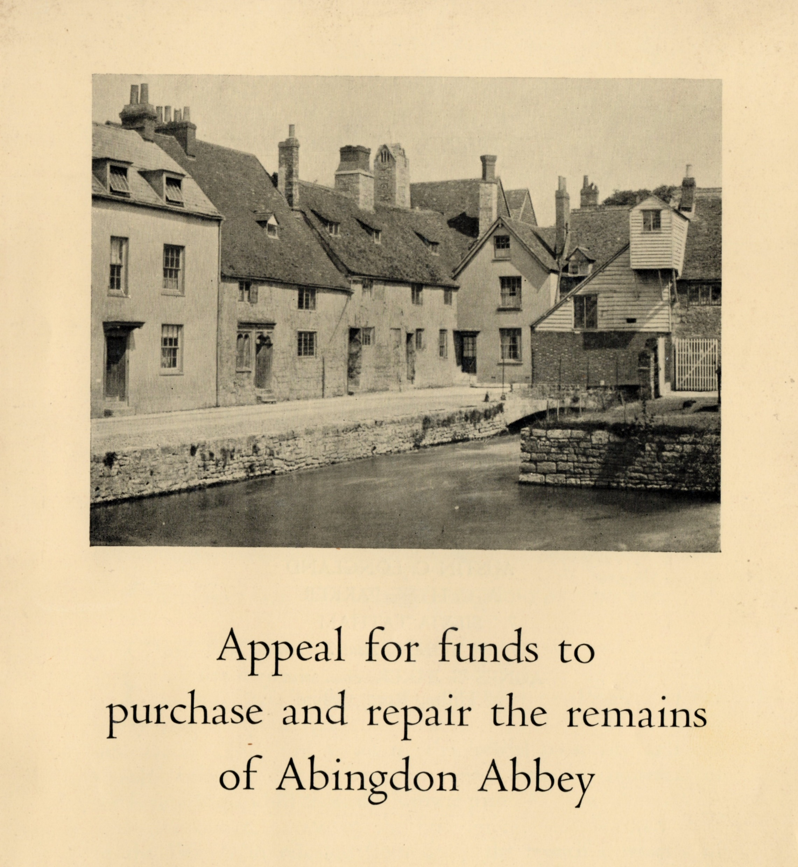
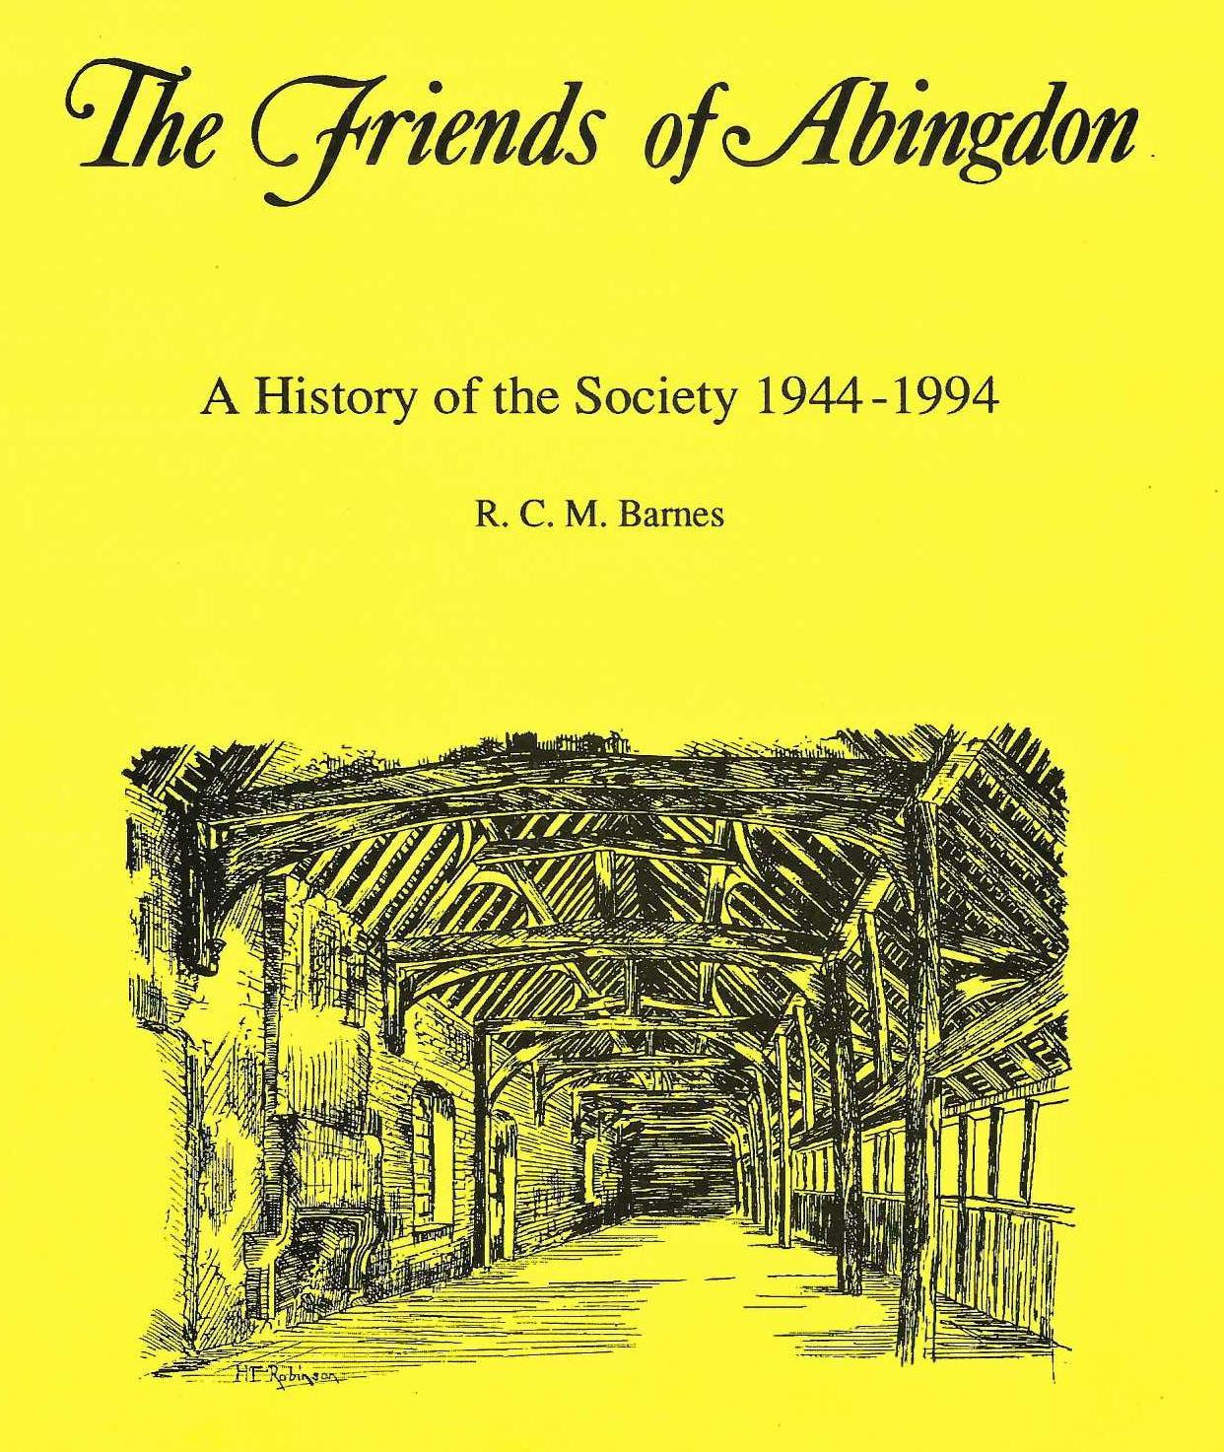
Notes:
115 people attended an inaugural meeting on 4 May 1944
Their primary intention was not to actually buy threatened properties, but, when they became aware of a threat to demolish parts of the medieval Abbey domestic buildings , they decided to purchase and recondition them as an example of what could be done.
That purchase – of what is now the Unicorn Theatre and adjacent cottage - was complete by February 1945 and over the next 2-3 years they bought the remainder of the current site.
And of course funds had to be raised to pay for all of this.
The history of the restoration of the buildings is described in Dick Barnes book and at https://www.abingdonabbeybuildings.co.uk/abbey-buildings/rescue-maintenance/

Slide 4
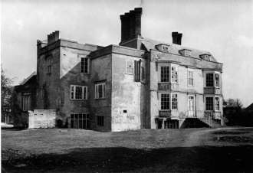
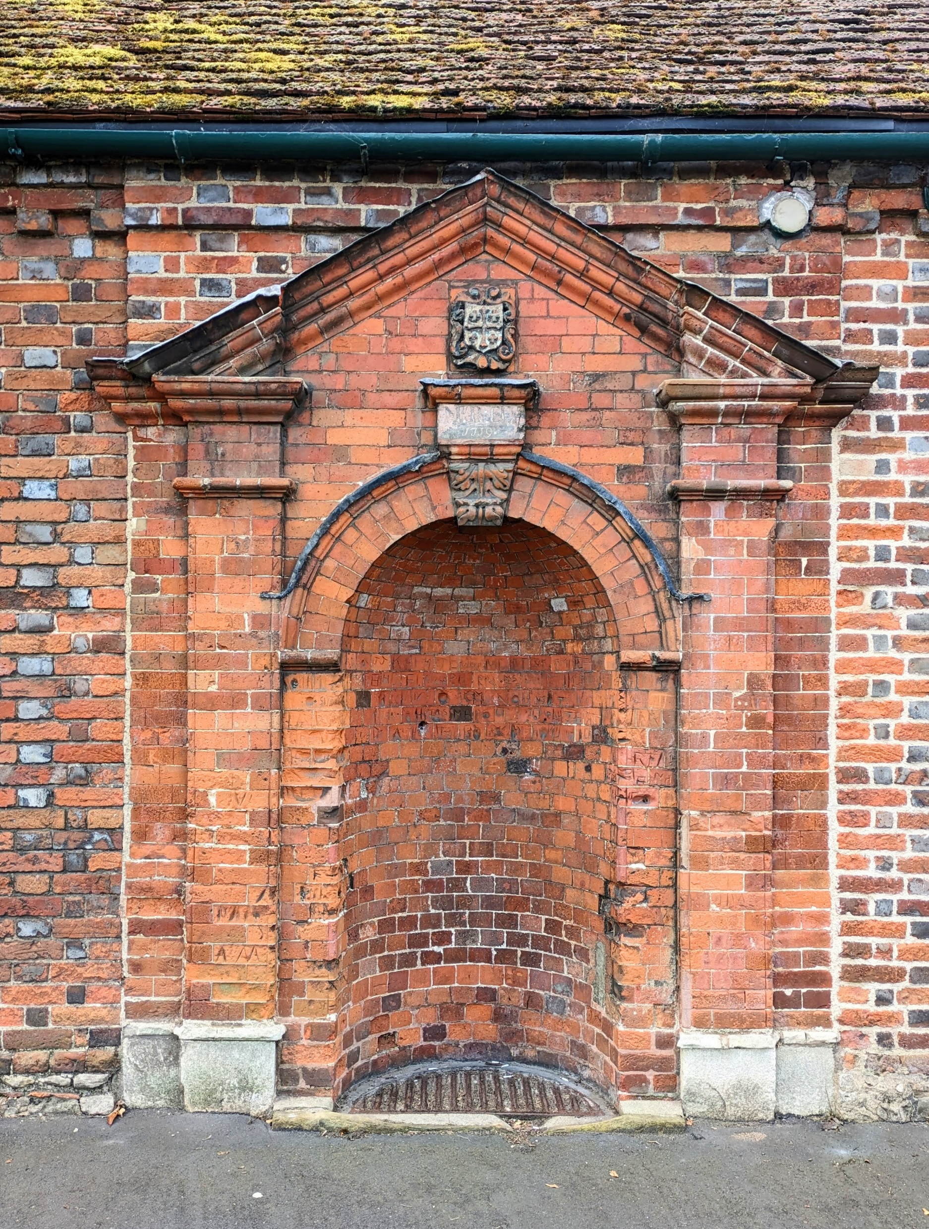
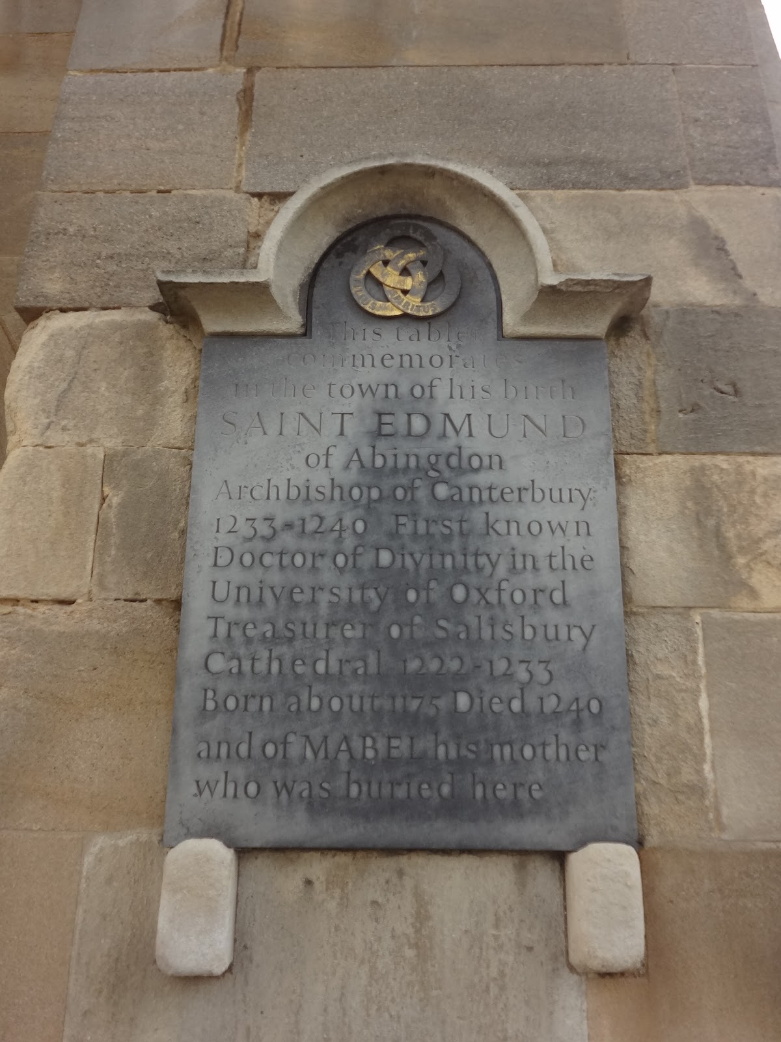
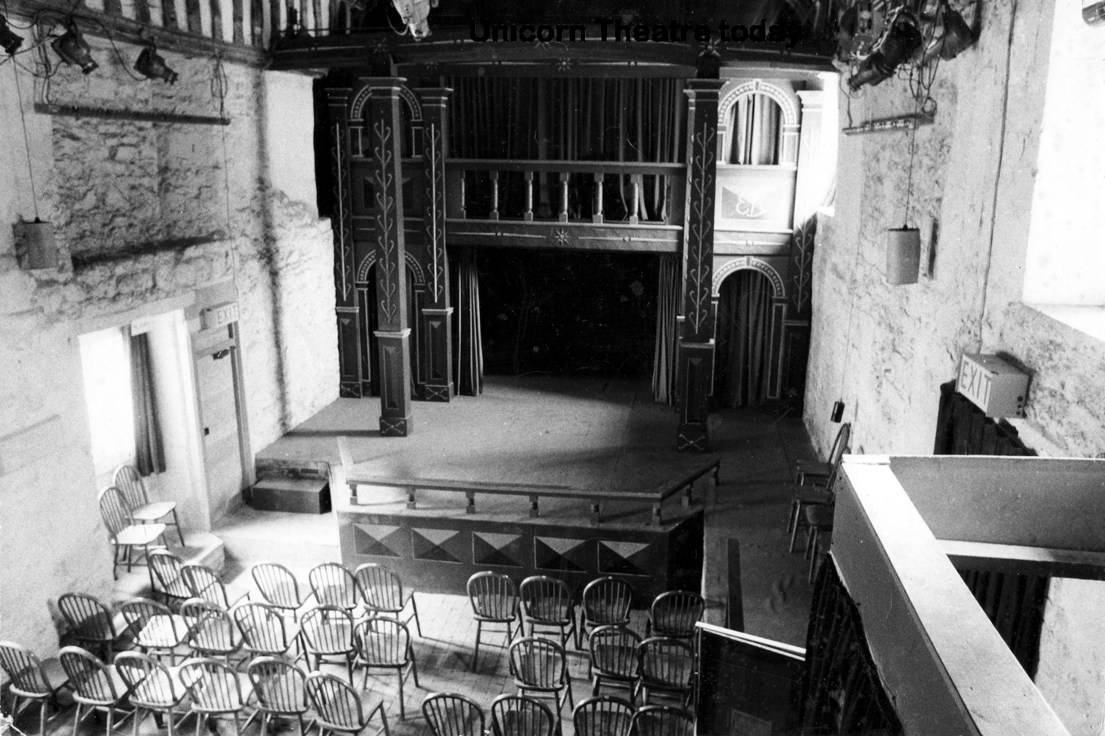
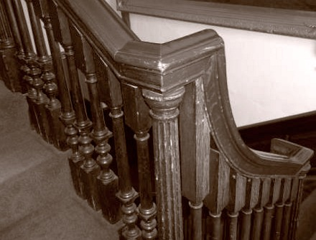
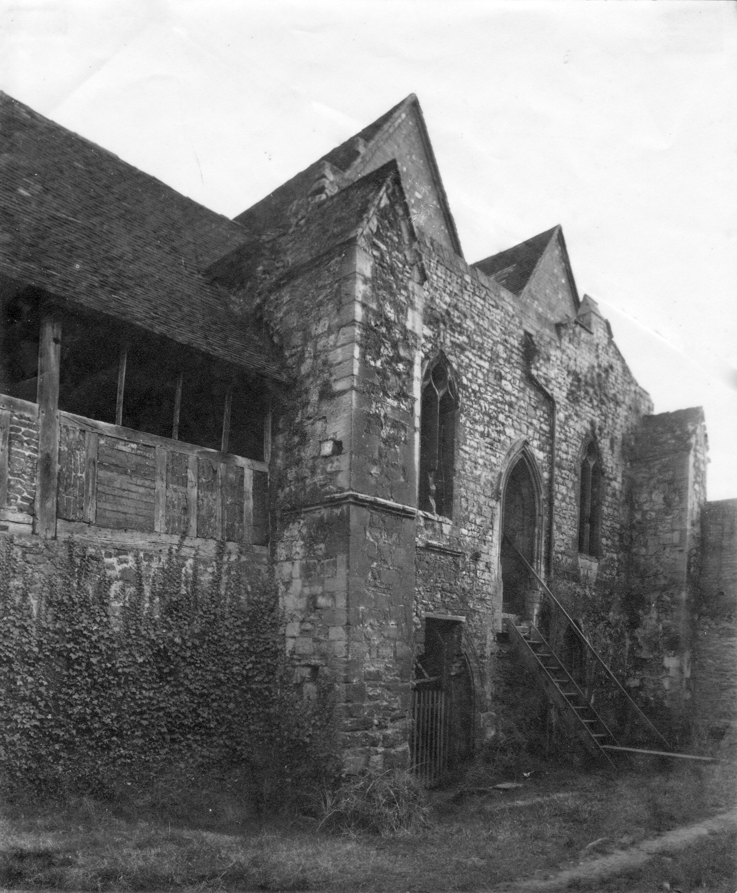
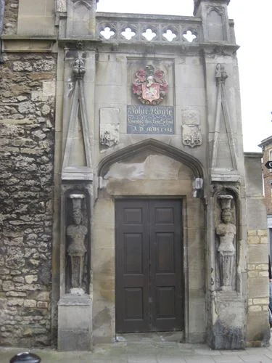
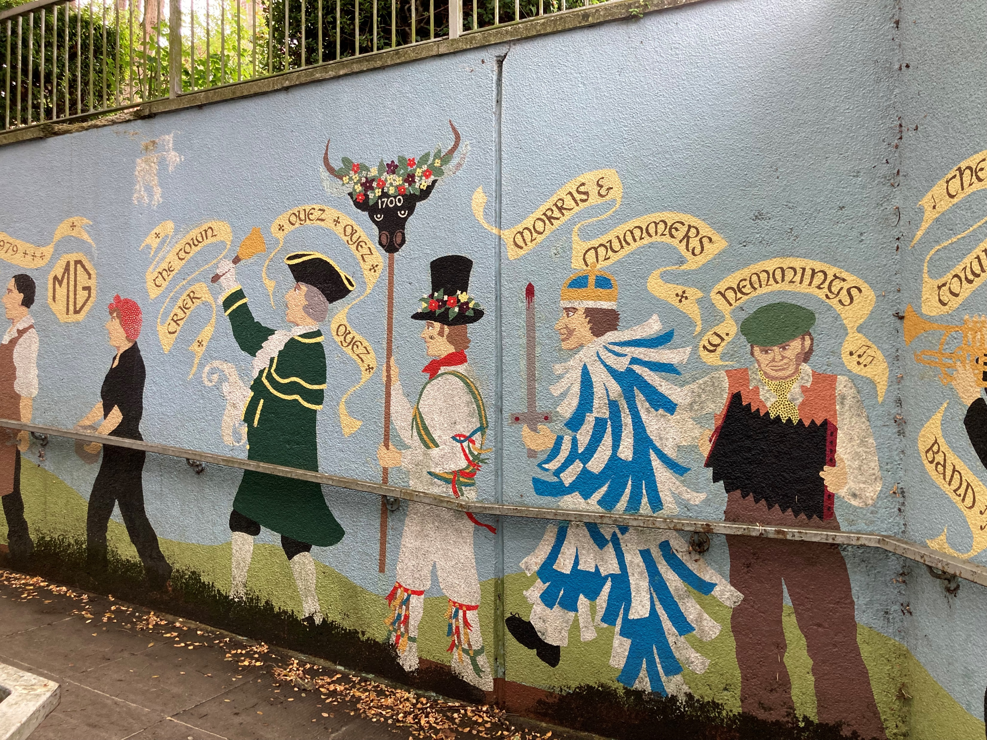
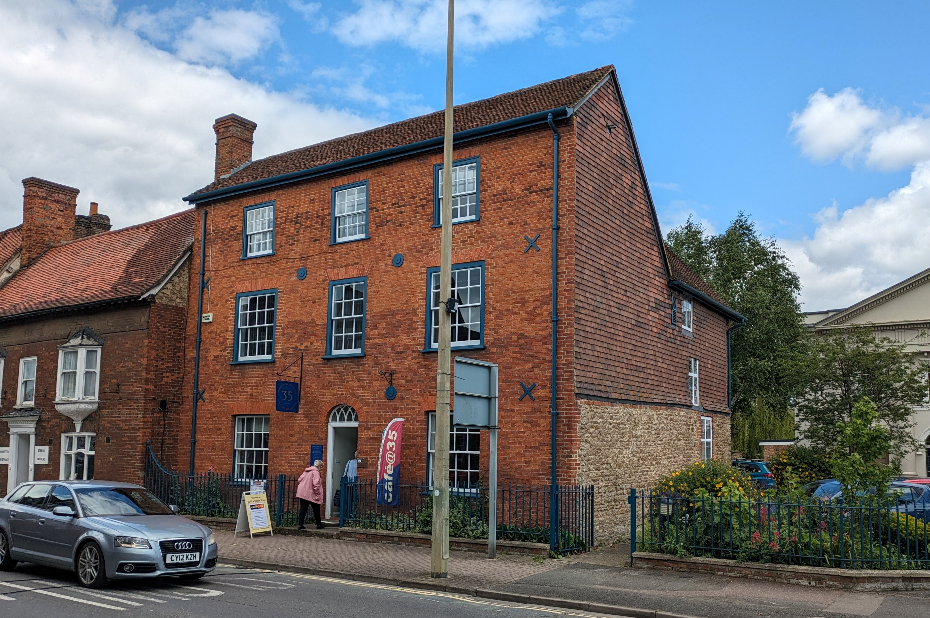
Notes:
Less well-known are the other projects which the Friends have been involved with over the years – some of them sadly less successful than others. They include:
Fitzharris Manor House – Friends lobbied from 1948 – 1953 for it to be saved, but to no avail. They did however manage to save many internal features, panelling, fireplaces etc although sadly these were all eventually sold off.
The 18th century Carswell Fountain – moved in 1948 from perilous position in Ock St
The Memorial to St Edmund at St Nicolas Church: the Friends spearheaded and fundraised for it in the1960s
The Roysse Archway – the Friends successfully opposed Borough Council plans to move it in the early 1950s
The Town Centre Murals – the Friends played a major role in these 1980s/1990s projects
35 Ock St the Friends successfully fought plans to demolish it in the 1980s
And most recently – the 1831 staircase in the Guildhall, saved from destruction in 2018

Slide 5
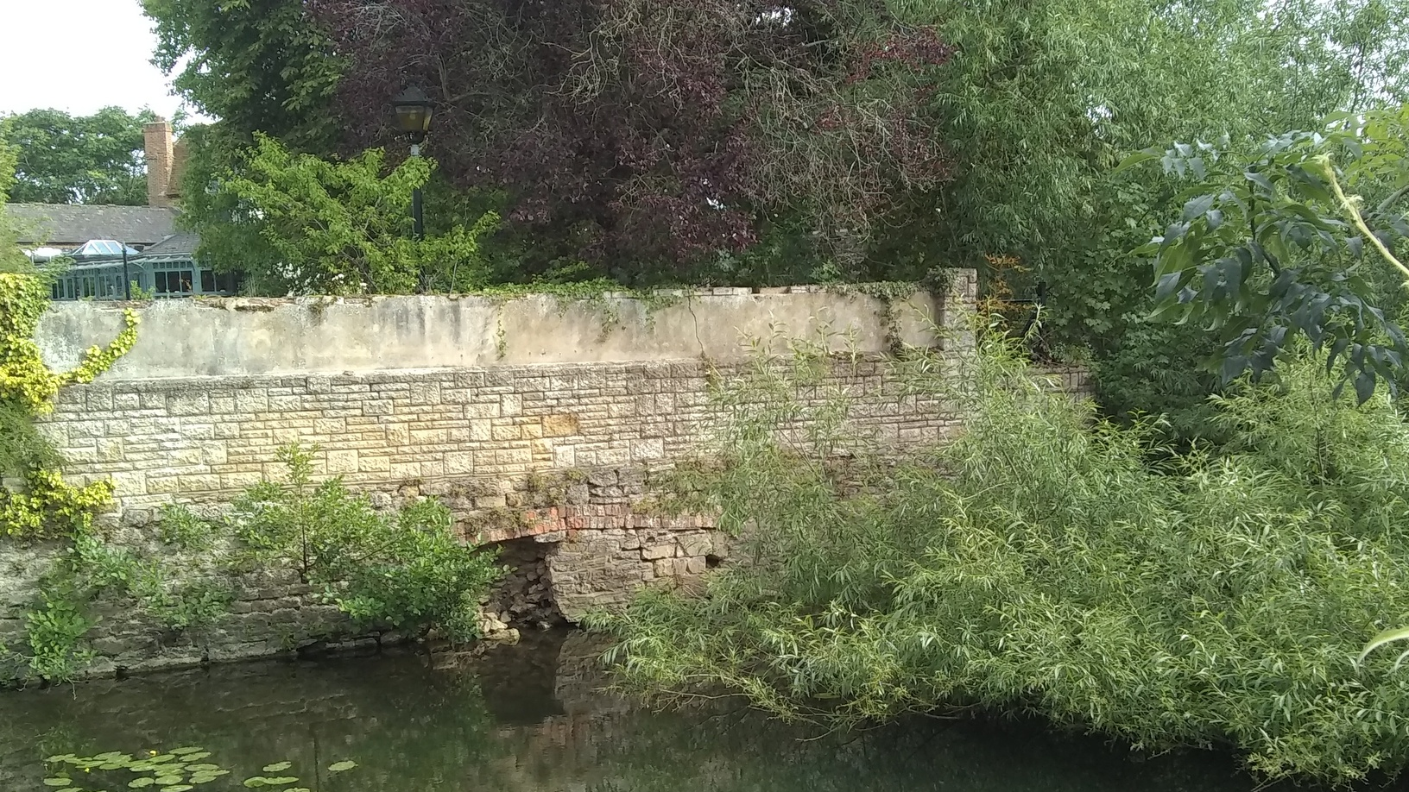
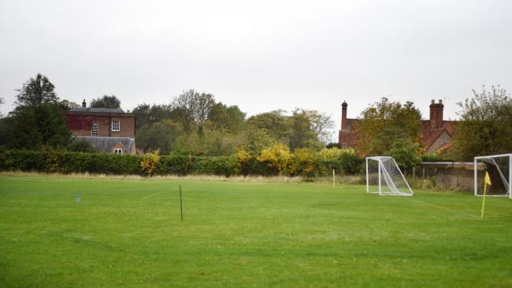
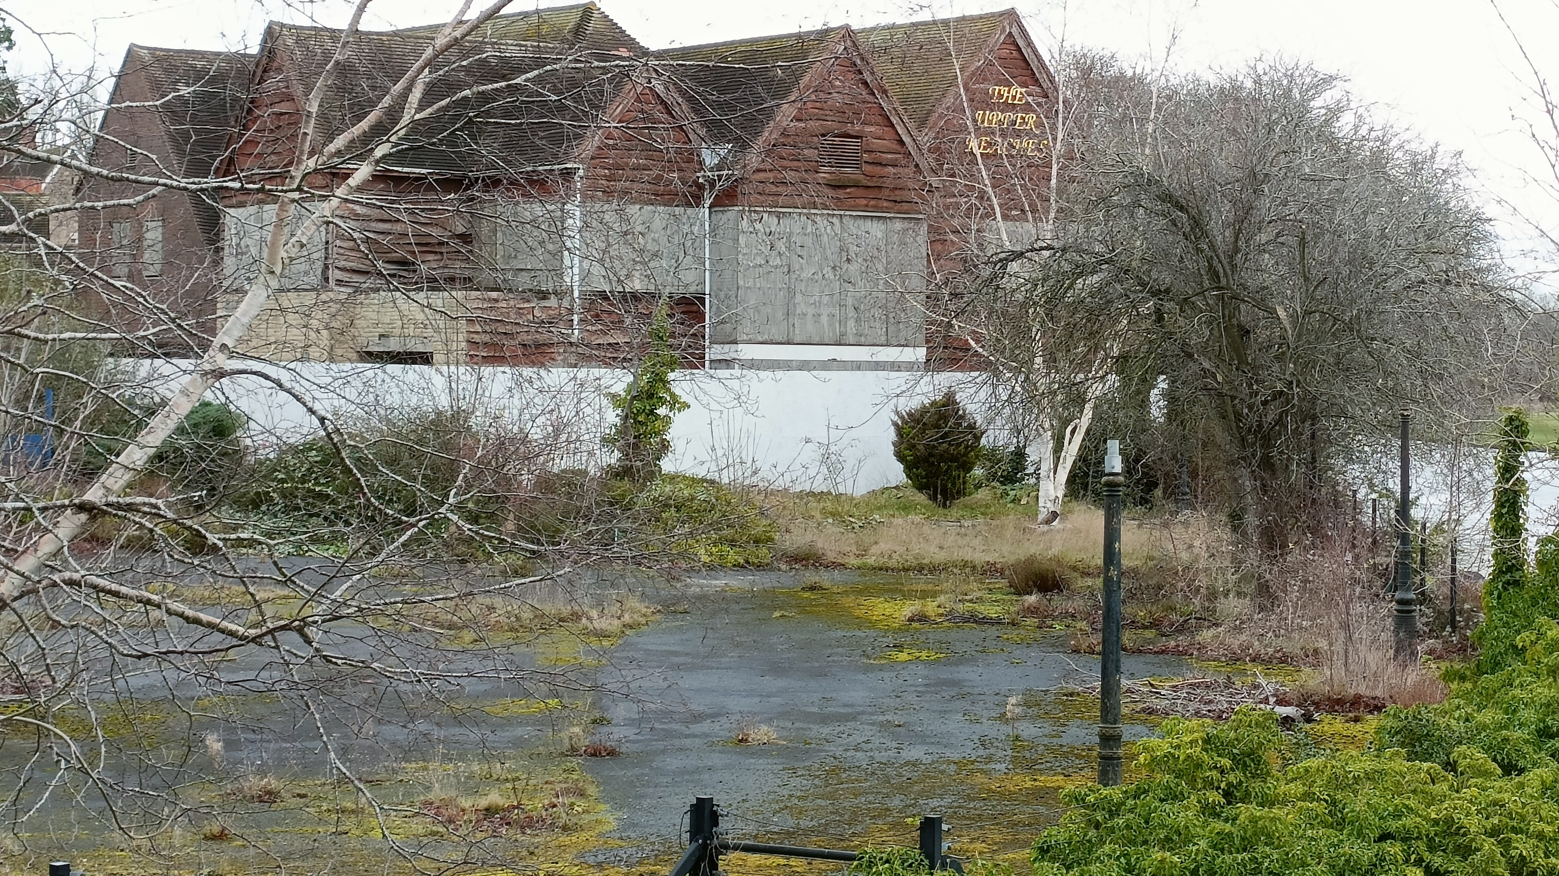
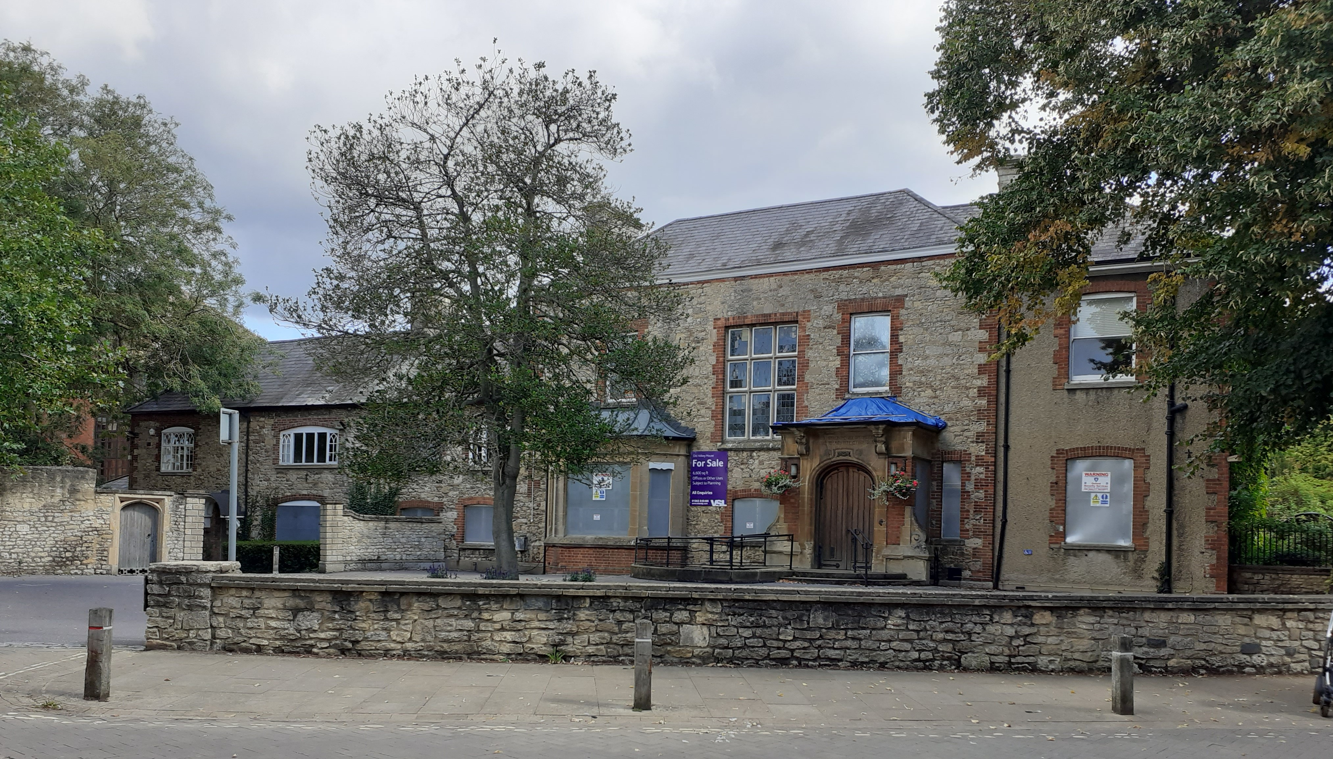
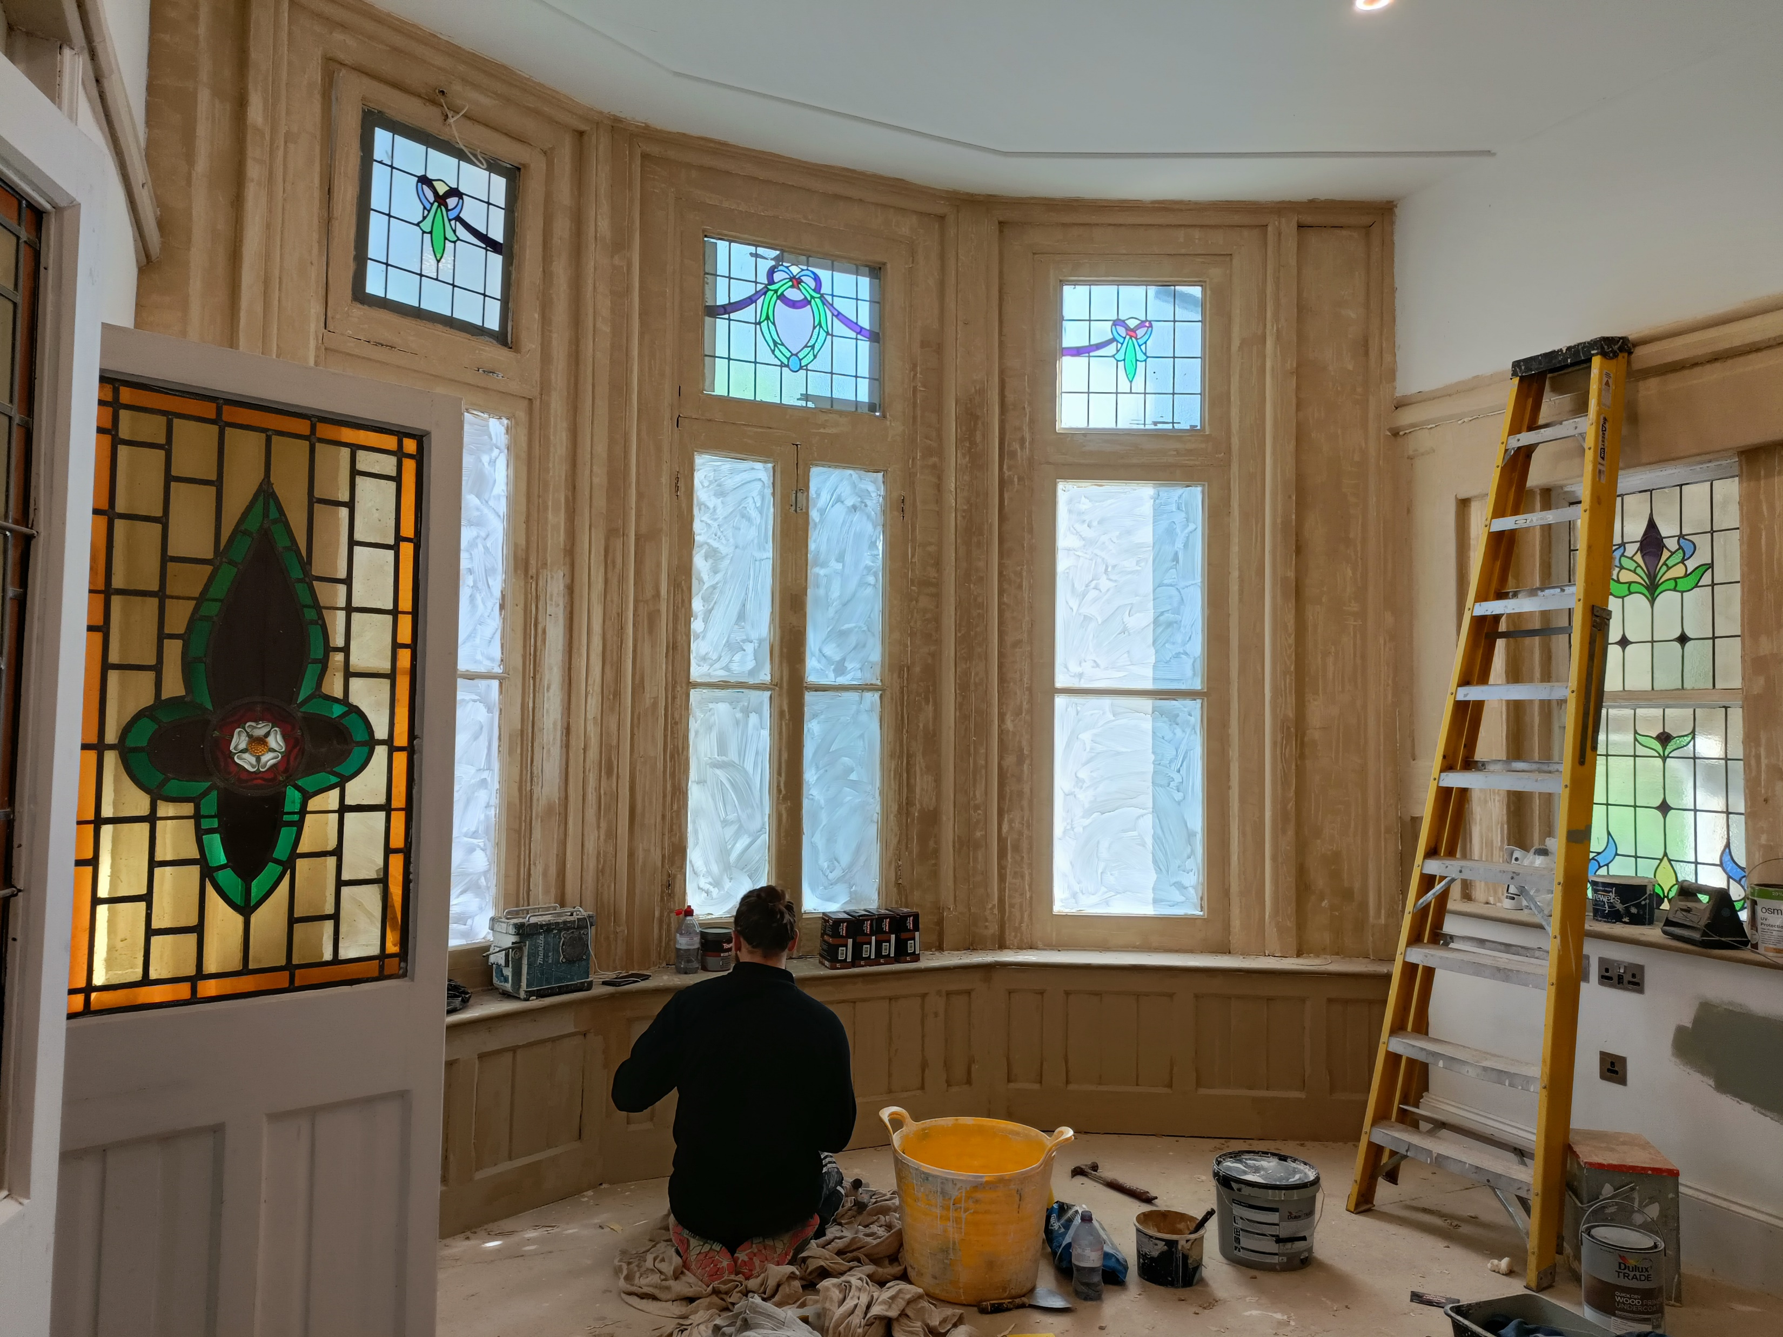
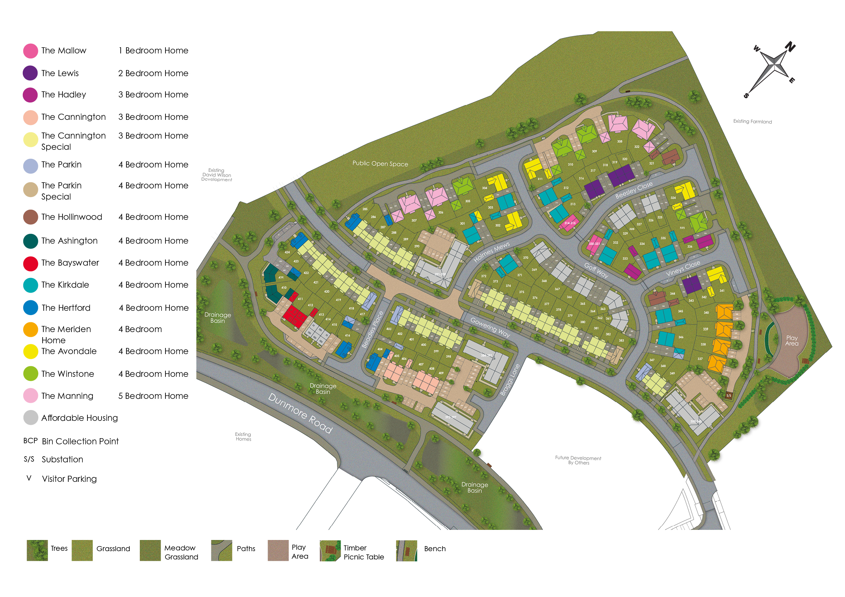
The Present
Notes:
In 2019 the charity divided into two separate organisations, one to focus on the Abbey Buildings and one for protecting other parts of the town’s heritage and promoting interest in the town. The rest of this presentation is about the latter.
Old Abbey House – a partial success. Saved from dereliction, but sadly no community access.
The Upper Reaches site – a major concern. Nine years since its closure and there is little evident progress towards a new use. We have regular update meetings with the Vale and following lobbying from us they did eventually require the leaseholder to put more secure (but still ugly) hoardings in place and tidy up the site a bit. We continue to monitor it closely and raise concerns over serious dilapidation (such as the crumbling riverside wall shown).
Northcourt cricket ground – a definite success. We worked with local residents and other groups to successfully oppose a plan to build 9-10 flats on this green space in a Conservation Area.
North Abingdon Housing developments - we are pressing for the provision of the promised Central Service area and for the CIL monies from the development to be used to best effect. We have a ”seat at the table” for useful meetings with the developers and Councillors.

Slide 6
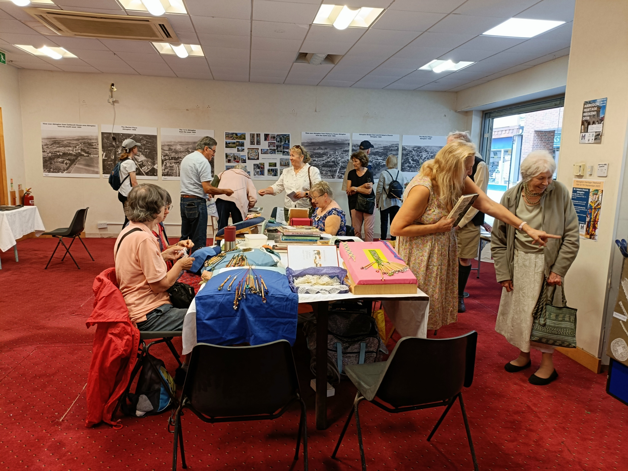
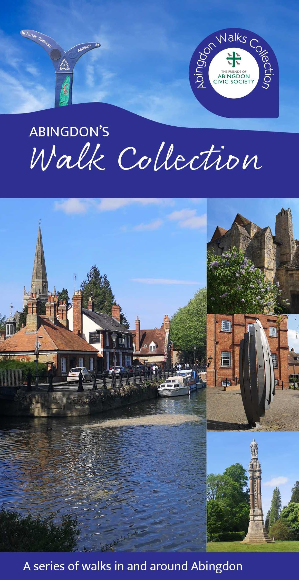
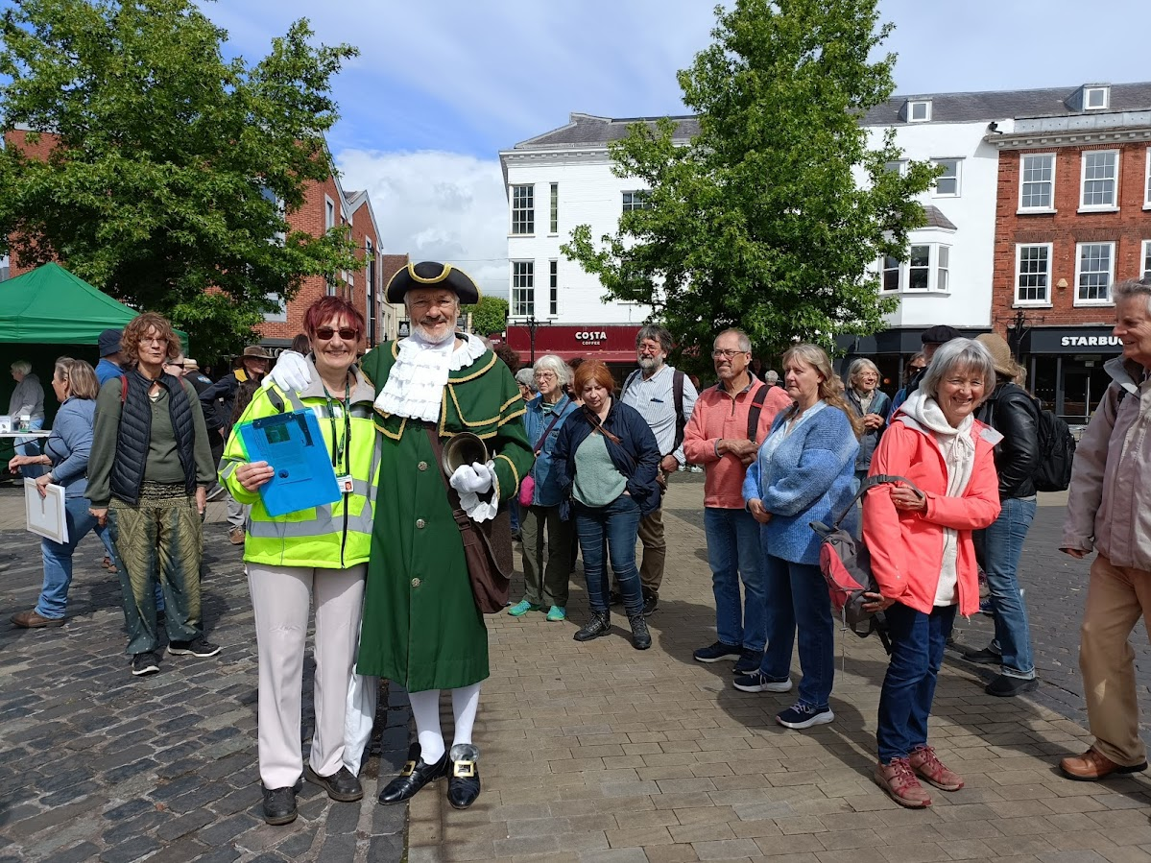
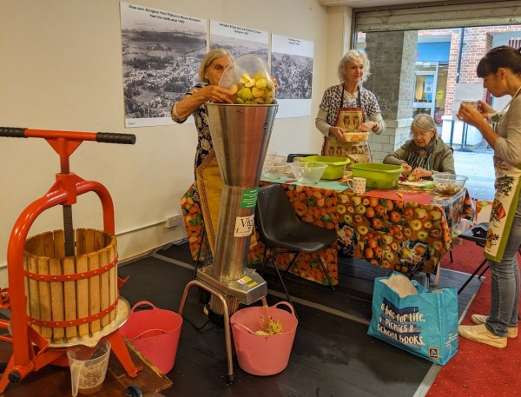
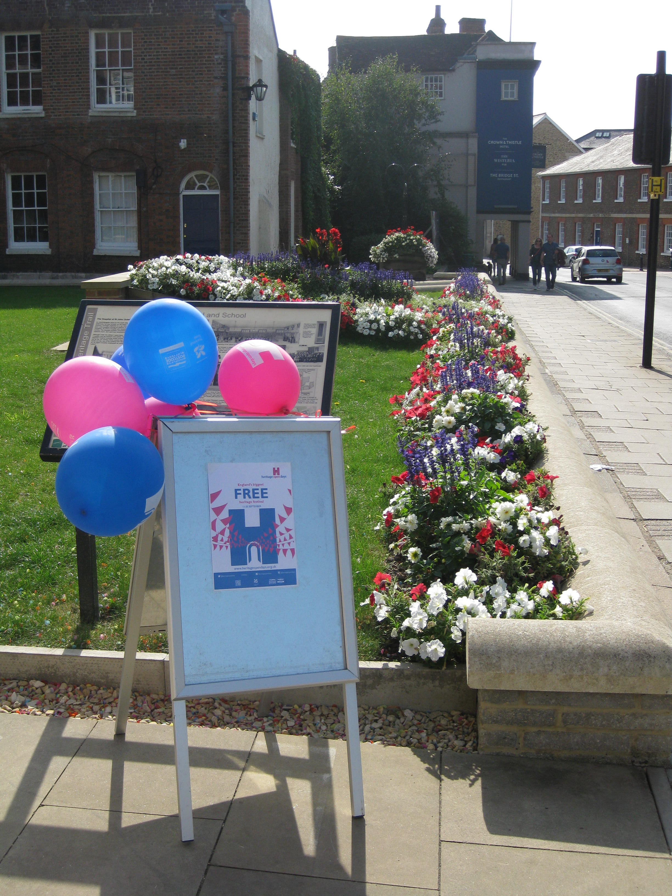
Notes:
But its not all about Planning. Bearing in mind that original objective of “arousing in all people a lively and practical interest in the town, we run several other projects which are much more fun!
Heritage Open Days – every September
Guided walks – May and September
We have produced a lovely collection of self-guided walks leaflets
Unit 24 – a Community Space which we make available at little or no cost to other groups for a very wide range of activities and which is proving creating sometimes unexpected and creative collaborations!
We are working on a “Picturing Abingdon” digital archive where people will be able to easily access some fascinating visual material about the town’s history
We have a new project with the OX14 Learning Partnership (all 6 secondary schools) to help them develop a sense of place among their students
Our thanks go to all three Councils who have at various times helped with funding towards these activities.

Slide 7
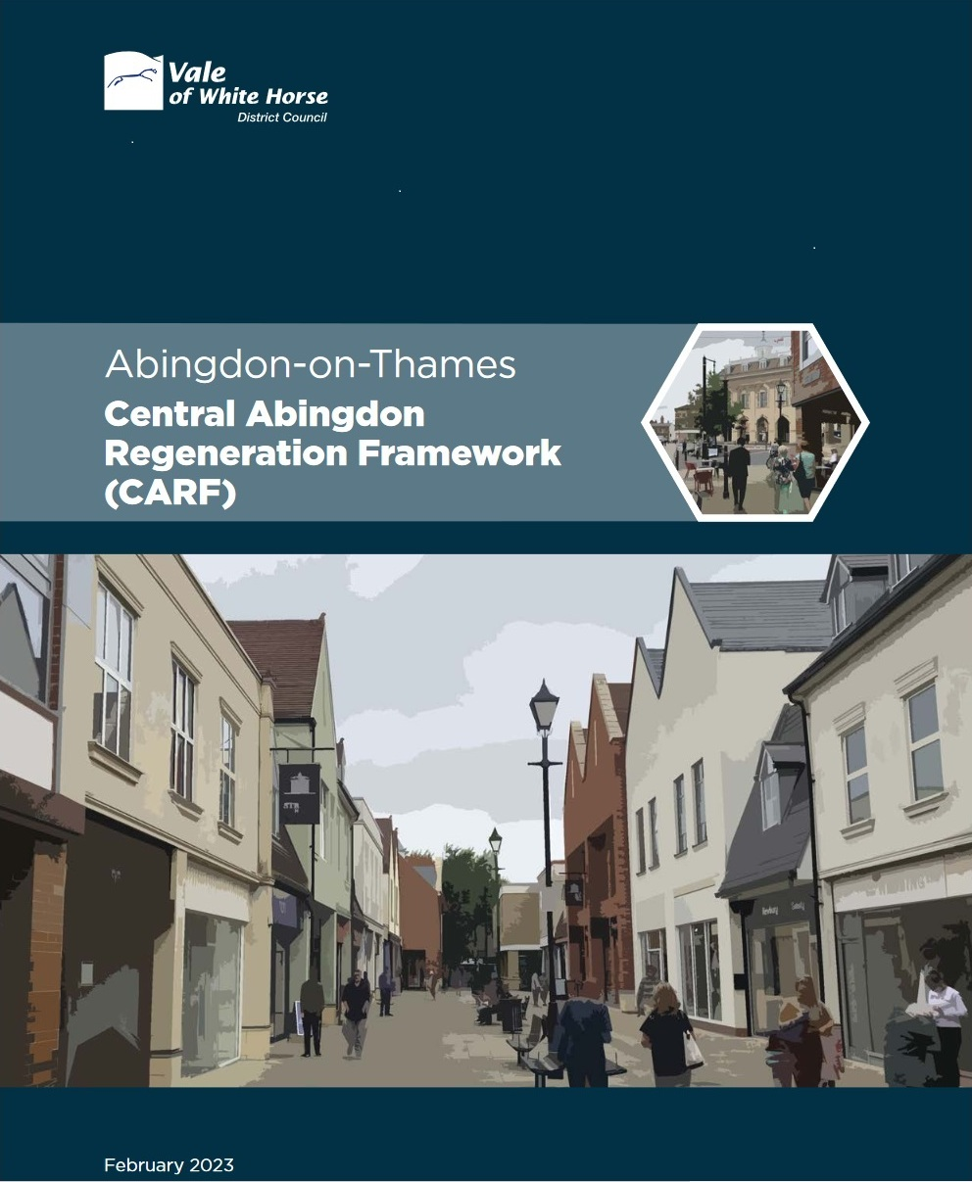
The Future – never again?
Notes:
Many people still lament the loss of historic buildings especially during the 1960s town centre redevelopment.
But many of those buildings were effectively slums - the real problem was what was built in their place. However the “precinct” was state of the art at the time – and in its early years was full of bustling shops. Could the developers, or councillors, have predicted that design tastes – and shopping habits - would change as much as they have? And this is most certainly not an Abingdon-only problem.
So how can we make sure the same mistakes are not made in future? The Town Council’s emerging Abingdon Neighbourhood Plan and the Vale’s Joint Local Plan and Central Abingdon Regeneration Framework will all guide future developments in the town and the Friends are contributing to all of these.
We want to encourage the wider community to do the same – but sadly many do not believe they will be listened to, so don’t think it worth their while.

Slide 8
Where next for the Civic Society?
Positive communication and engagement
Harnessing the power of the community
Constructive and collaborative relationships with the Councils
The next generations
Inspiring young people
Passing on the volunteer baton to those able to carry it
Notes:
We try to engage constructively in discussions about civic matters – and to encourage others to do so – NIMBYISM and negativity don’t usually achieve results.
Abingdon has always had a lot of voluntary groups and several new ones have set up in recent years which are attracting a new generation of volunteers. We need to work with them to create a sum greater than its parts.
We need to work with Councils – albeit sometimes as “critical friends”: we have people with time, experience, skills – and long memories - which can supplement their resources, if they trust us.
And, as individuals, we need to know when it is time for us to retire gracefully and hand on the baton to others – we need new members!
Mr Etty said at that meeting 80 years ago: “while it might seem out of place to consider the preservation of a few old buildings in one small town during a time of world-wide destruction, it is necessary to plan so that the children of the future might grow up amongst beautiful things.” I can’t think of a better reason for us to do what we do.

